Slide 1
Topics
Angular JS Services overview
Built-in services
Custom Services
ngResource

Slide 2
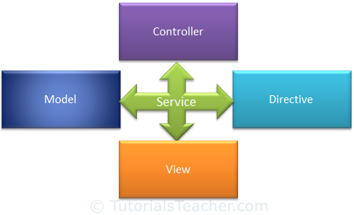
Services overview
A service in angular is simply an object that provides functions for specific task which can be reused throughout the application.
Angular JS includes built-in services for different purpose.
All angular services are lazy initialized and are singleton, and all the components of the application share the same instance.
Angular JS allows us to create custom services for our application.

Slide 3
Advantages of Angular JS
Re-usability
Dependency Injection
Testability.

Slide 4
Built-in services
Angular JS provides several built-in services.
In runtime these services are automatically registered with the dependency injector, so you can easily incorporate then into your angular applications by dependency injection.
Few commonly used built-in services
  $http - $log
  $interval - $timeout
  $location - $cookies
  $window - $animate

Slide 5
$http
Angular JS $http service is used for asynchronous communication using XMLHttpRequest object (Ajax http request).
$http is designed for general purpose AJAX calls that can deal with both RESTful & Non-RESTful API on your server.

Slide 6
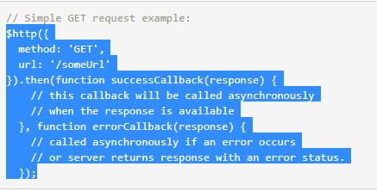
General usage

Slide 7
The response object has these properties:
data – {string|Object} – The response body transformed with the transform functions.
status – {number} – HTTP status code of the response.
headers – {function([headerName])} – Header getter function.
config – {Object} – The configuration object that was used to generate the request.
statusText – {string} – HTTP status text of the response.

Slide 8
ngResource
AngularJS ngResource module provides built-in support for interacting with RESTful services asynchronously, via $resource service.
$resource is a higher-level abstraction on low-level $http service used for asynchronous server communication.
If you don’t have a RESTful API on your server, you should then be using $http instead.

Slide 9
Using ngResource
1. Include angular-resource.js in your HTML.
<script src="js/angular.min.js"></script>
<script src="js/angular-resource.min.js"></script>
2. Load the module in your application by adding it as a dependent module:
var myApp = angular.module('app', ['ngResource']);
3. Create a service around your REST API end-point, using $resource.
app.factory('EventResource', ['$resource', function ($resource) {
return $resource('http://localhost:8080/EventProject/Participant/:participantId‘,
{participantId: @participantId}, //params
{ } , // actions
{ }); // options
}]);
The resource object contains following default methods for specific HTTP actions:
'get': {method:'GET'},
'save': {method:'POST'},
'query': {method:'GET', isArray:true},
'remove': {method:'DELETE'}, //Preferable over delete due to IE incompatibilities.
'delete': {method:'DELETE'}

